Slide 1

Centre for Project Management
Welcomes you to
Post Graduate in Advanced Project Management
Batch 33 – PG-APM

Slide 2
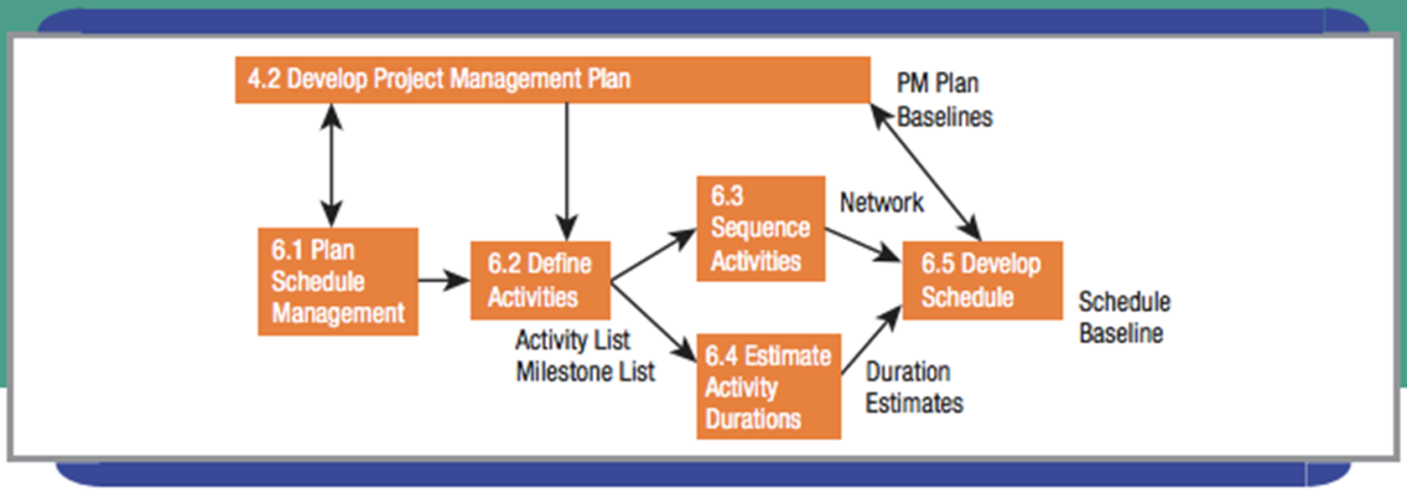
Scheduling Projects

Slide 3
Difference between Scope and Schedule
To put this simply, the scope is the WHAT in breadth and depth. The schedule provides additional dimensions including WHEN, WHO and HOW MUCH

Slide 4
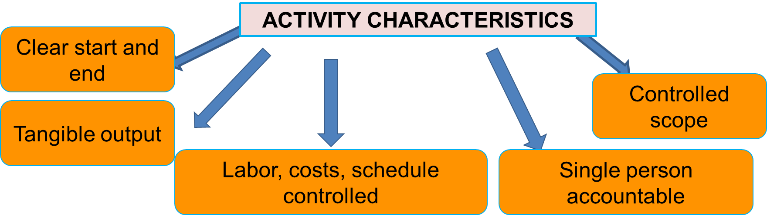
Plan Schedule Management (1 of 2)
Building blocks of a project schedule are activities
Activity – “a component of project scope work performed during the course of a project.” – P M I

Slide 5

Purposes of a Project Schedule (1 of 2)
What is the earliest a particular activity can start, and when will it end?
What would happen if a delivery of material was one week late?
What activity must begin before which other activities can take place?
If one worker is assigned to do two activities, which one must go first?
When will the project be complete?

Slide 6
Purposes of a Project Schedule (2 of 2)
Which worker or other resource is a bottleneck, limiting the speed of our project?
What will the impact be if the client wants to add another module?
Can a key worker take a week vacation the first week of March?
If I am willing to spend an extra $10,000, how much faster can the project be completed?
How many hours do we need from each worker next week or month?
Are all of the activities completed that should be by now?

Slide 7
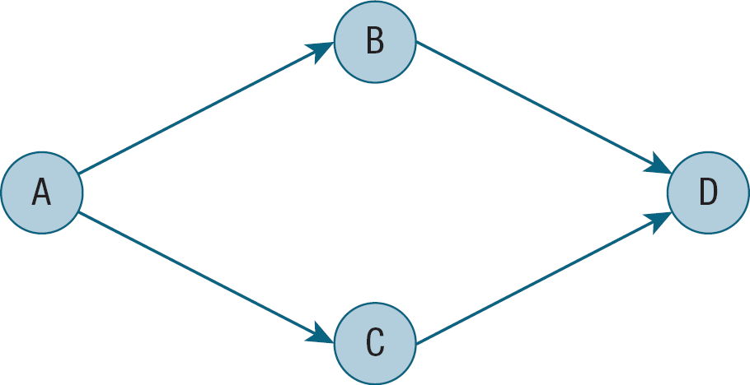
Activity on Node (A O N) or Precedence Diagramming Method (P D M)
Most widely used
EXHIBIT 8.1: A O N FORMAT SCHEDULE EXAMPLE
node = activity
arrow = sequence
Precedence Diagramming Method (P D M) – scheduled activities are represented by “nodes,” and arrows are used to show the logical sequence

Slide 8
5 Factors Limit Project Completion
Logical order in which activities need to be completed
How long each activity will take
How many key resources are available at specific points in the project
Imposed dates
Cash flow

Slide 9
Creation of Project Schedules
Identify all activities
Determine logical order
Estimate time required for that activity
Assign resources to each activity
Compare schedule with imposed dates
Consider project budget and cash flow, quality demands, and risk factors

Slide 10

The Project Manager’s Responsibility
Resist pressure to dictate a schedule
Determine a schedule that is possible
Persuade stakeholders that the schedule makes sense
Deliver project according to the agreed-upon schedule
Within each iteration, team considers level of uncertainty & complexity with desired outcomes
Number of team members as resources is often primary limitation

Slide 11
Define Activities (2 of 2)
Don’t omit activities
Activity sequencing may uncover missing activities
Schedule will not be approved until all related planning is in place
Avoid adding activities after final schedule is approved
Use previous projects, templates, or checklists as a starting point

Slide 12
List Project Milestones
Completion of a major deliverable or critical activity
Prior to a large financial commitment
Merging point in project schedule

Slide 13
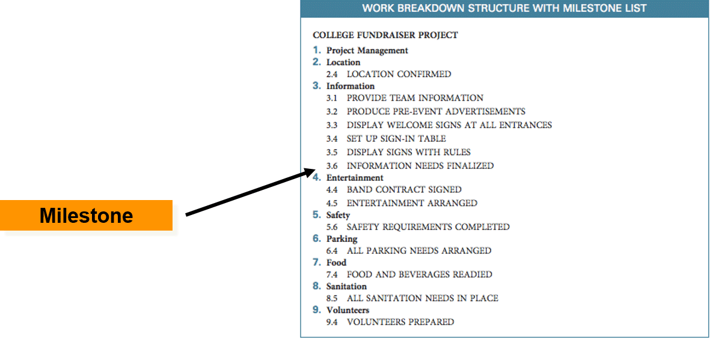
W B S with Milestone List

Slide 14
Sequence Activities (1 of 2)
What activity or activities can be started right away and do not depend on any others?
Successor activity – an activity that logically follows another activity or activities
Predecessor activity – activity that logically precedes another activity or activities
What activity or activities can we start next?

Slide 15
Sequence Activities (2 of 2)
Place a successor activity after its predecessor
Draw arrow to show the relationship
Continue until all activities have been placed on the work surface
Dependencies can be mandatory or discretionary
Mandatory dependency – logical relationship that must be followed (generally due to physical or contractual demands)
Discretionary dependency – a preferred logical relationship, based on best practices and judgment

Slide 16
Activity List for Product Upgrade Project
Determine product features
Acquire prototype materials
Produce prototype
Design marketing campaign
Design graphics
Conduct marketing
Perform sales calls

Slide 17
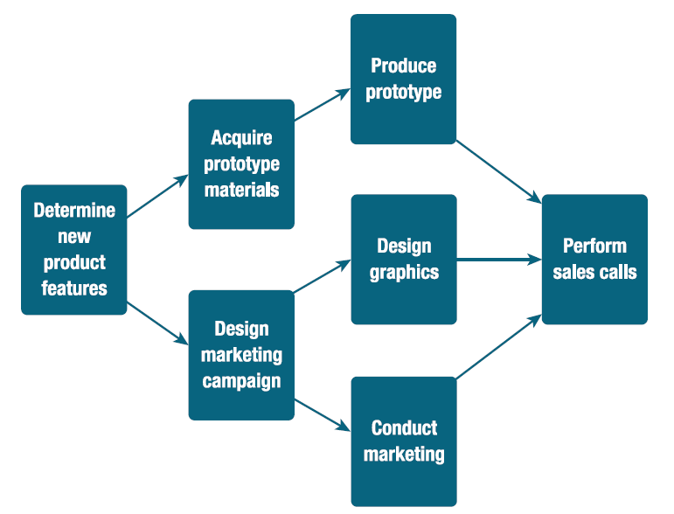
Network for Product Upgrade Project

Slide 18
Leads and Lags
Lead – “a modification of a logical relationship that allows an acceleration of the successor activity.” Practice Standard for Scheduling (P M I)
Lag – “a modification of a logical relationship that directs a delay in the successor activity.” Practice Standard for Scheduling (P M I)
Leads are helpful if a project needs to be completed quickly
Finish-to-start – “a logical relationship where initiation of work of the successor activity depends upon the completion of work of the predecessor activity.” Practice Standard for Scheduling (P M I)
Finish-to-start (F S) dependency -most common type

Slide 19
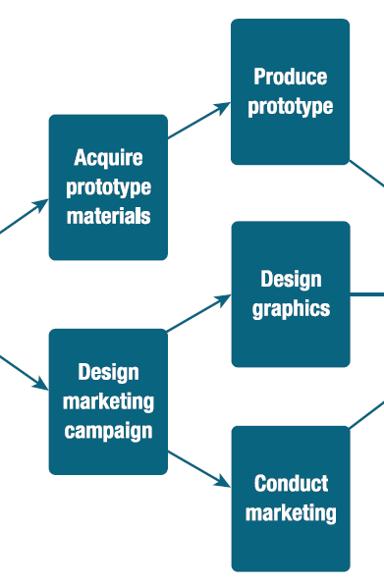
Finish-to-finish Relationships
Example: Graphics could be designed while marketing campaign is being designed, but not completed until marketing campaign is completed.
Finish-to-finish (FF)– “the logical relationship where completion of work of the successor activity cannot finish until the completion of work of the predecessor activity.”
-Practice Standard for Scheduling (P M I)

Slide 20
Start-to-start Relationships
Examples: Graphics design could not start until marketing design started
Start-to-start – “a logical relationship where initiation of the work of the successor schedule activity depends upon the initiation of the work of the predecessor schedule activity.”
-Practice Standard for Scheduling (P M I)

Slide 21
Start-to-finish Relationships
Least used relationship
Example – a project to replace an old system where the new capability must be started before the old one is completely discontinued
Start-to-finish – “the logical relationship where completeness of the successor scheduling activity is dependent upon the initiation of the predecessor schedule activity.” -Practice Standard for Scheduling (P M I)

Slide 22
Estimate Activity Duration
Evaluate each activity independently
Document all assumptions & constraints
Changing assumptions & constraints could change estimates
Duration – “the total number of work periods (not including holidays or other non-work periods) required to complete a schedule activity… usually expressed as workdays or workweeks.”
-Practice Standard for Scheduling (P M I)

Slide 23
EXHIBIT 8.7: Activity Duration Estimate Example
TIME ESTIMATE IN WORKDAYS | ACTIVITY NAME
5 | Determine new product features
20 | Acquire prototype materials
10 | Produce prototype
10 | Design marketing campaign
10 | Design graphics
30 | Conduct marketing
25 | Perform sales calls

Slide 24
Suggestions for Creating Realistic Time Estimates (1 of 2)
Verify time estimations with the people doing the work
Estimate times without initial reference to a calendar
Make sure all time units are identical: working days, work week, months (consider time off for company holidays)
Consider time constraints (see following slide!)
Acknowledge tendency toward optimistic or pessimistic estimations
Be realistic
Adjust estimates based on size, familiarity, & complexity differences

Slide 25
Suggestions for Creating Realistic Time Estimates (2 of 2)
Possibly time constraints…
Learning curves
Unexpected meetings
Inaccuracy in work instructions
Vacation
Emergencies/illness
Resources or information not available on time
Interruptions
Re-work

Slide 26
Activity Duration Estimating Problems and Remedies (1 of 2)
POTENTIAL ACTIVITY DURATION ESTIMATING PROBLEM | REMEDY
Omissions | Refining scope and W B S Checklists, templates, devil’ sadvocate Lessons learned
General uncertainty in estimate | Rolling wave planning Reverse phase schedule Learning curve Identify and reduce sources of uncertainty Manage schedule aggressively
Special cause variation | Risk analysis Resolve risk events
Common cause variation | PERTMonte Carlo Project buffer
Merging (multiple predecessors) | Milestones Reverse phase schedule Feeding buffer Manage float

Slide 27
Activity Duration Estimating Problems and Remedies (2 of 2)
POTENTIAL ACTIVITY DURATION ESTIMATING PROBLEM | REMEDY
Queuing | Staggering project start dates Resource leveling Resource buffer
Multitasking | Prioritizing projects Carefully authorize start of noncritical activities
Student syndrome (starting late) | Float Critical path meetings
Not reporting early completion of rework | Project culture Project communications Contract incentives Project leadership Progress reporting
Source: Adapted from Larry Leach, “Schedule and Cost Buffer Sizing: How to Account for the Bias between Project Performance and Your Model,” Project Management Journal 34 (2) (June 2003): 44.

Slide 28
Develop Project Schedules
Identify the critical path
  Determines project’s earliest possible end date
  Most critical in terms of time
  Methods for determining critical path:
Two-pass method
Enumeration method
Critical path – “the sequence of schedule activities determining the duration of the project. Generally it is the longest path through the project.” -Practice Standard for Scheduling (P M I)

Slide 29
Two-Pass Method
Used to determine amount of slack each activity has
Make two logical passes through the constructed network
  The forward pass
  The backward pass

Slide 30
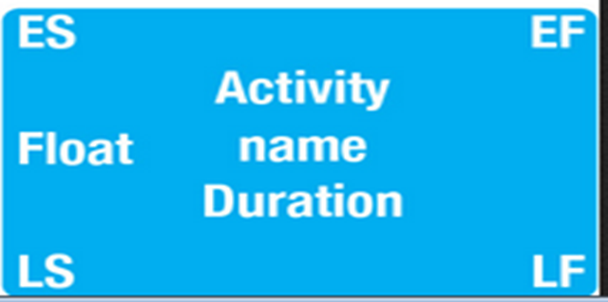
Times Important to Each Activity (1 of 2)
Early start date (E S) – “the earliest possible point in time on which uncompleted portions of a schedule activity can start, based upon the schedule network logic, the data date, and any schedule constraints.”
-Practice Standard for Scheduling (P M I)
Early finish date (E F) – “the earliest possible point in time on which uncompleted portions of a schedule activity can finish, based upon the schedule network logic, the data date, and any schedule constraints.”
-Practice Standard for Scheduling (P M I)

Slide 31

Times Important to Each Activity (2 of 2)
Late start date (L S) – “the latest possible point in time that a schedule activity can start, based upon the schedule network logic, the project completion date, and any schedule constraints.”
-Practice Standard for Scheduling (P M I)
Late finish date (L F) – “the latest possible point in time when a schedule activity can finish based upon the network logic, the project completion dates, and any schedule constraints.”
-Practice Standard for Scheduling (P M I)

Slide 32
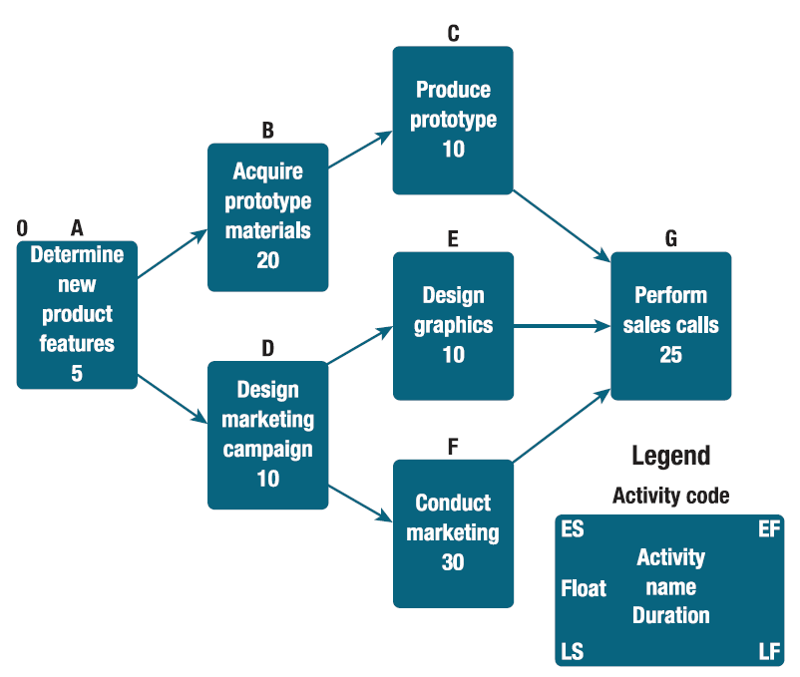
Two-Pass Example Schedule Set Up
Start at the beginning of the project and ask how soon each activity can begin and end

Slide 33
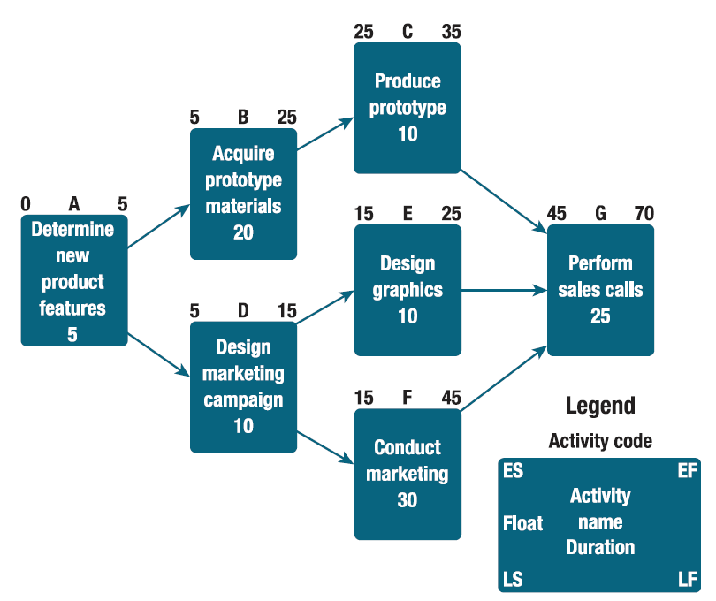
Schedule Example First Pass Complete
Forward pass—calculate Early Finish for each activity
E F = E S + Duration

Slide 34
Second or Backward Pass
How late can each activity be finished and started?
Backward pass – “the calculation of late finish date and late start dates for the uncompleted portions of all schedule activities. Determined by working backward through the schedule network logic from the project’s end date. Practice Standard for Scheduling (P M I)

Slide 35
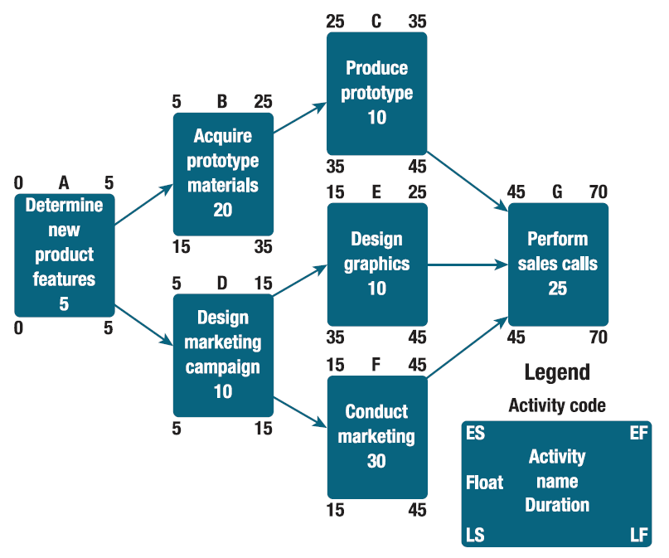
EXHIBIT 8.13: Schedule Example Second Pass Complete
Backward Pass—calculate Late finish & late start dates
Late finish date for last activity is same as early finish date
L F − duration = L S

Slide 36
Float and the Critical Path (1 of 2)
Total float – “the amount of time a schedule activity may be delayed from its early start date without delaying the project end date.” -Practice Standard for Scheduling (P M I)
Free float – “the amount of time a schedule activity can be delayed without delaying the early start of immediately following schedule activities.” -Practice Standard for Scheduling (P M I)
Compute the critical path based on float (slack)
Activities with no/very little float need to be scheduled very carefully

Slide 37
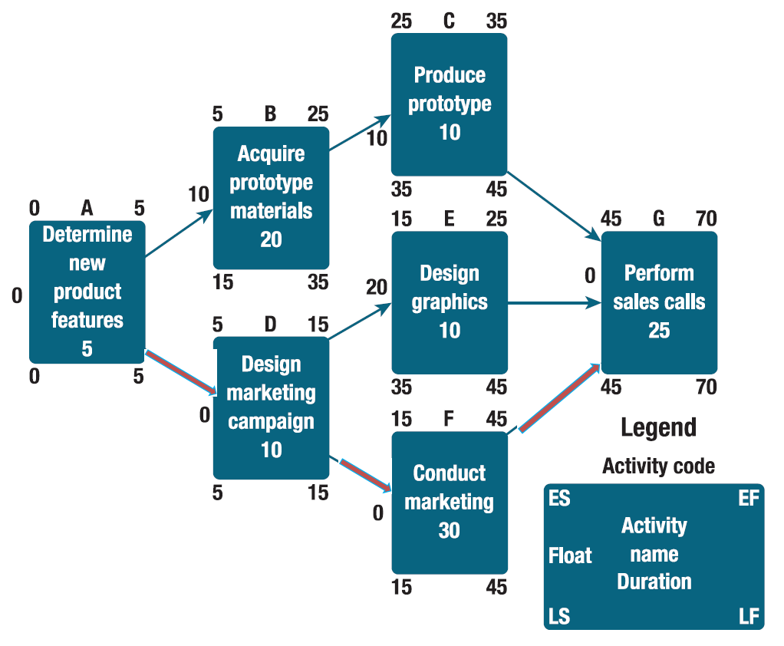
Float and the Critical Path (2 of 2)
TWO-PASS COMPLETE SCHEDULE EXAMPLE
Float = Late Start − Early Start (Float = LS − ES)
Critical path is the sequence of activities that has no float
A – D – F – G

